Slide 1
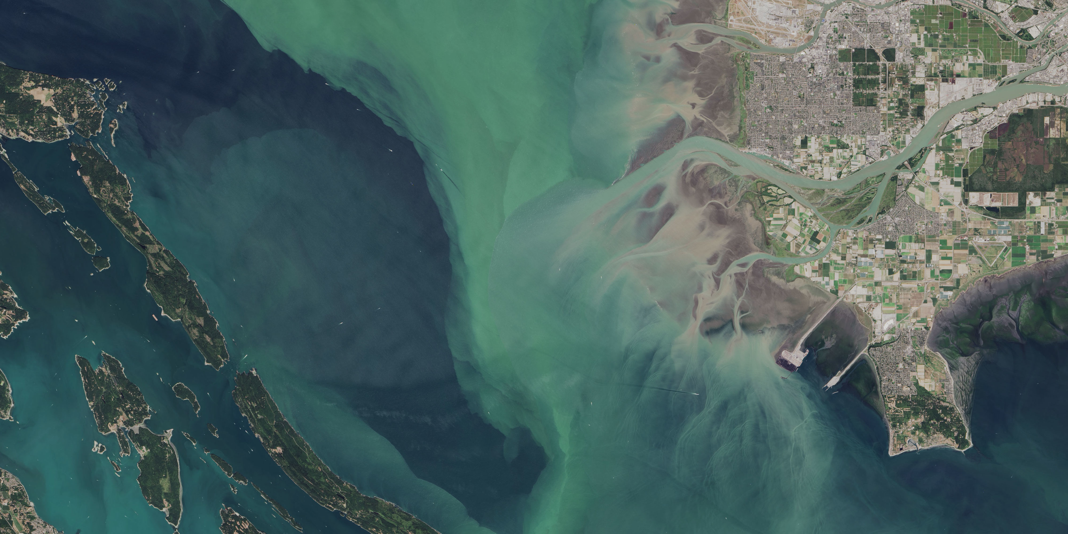
Analysis of Gene Co-expression Networks of Two Coccolithophore Species
Nitesh Sabankar
07/16/2018

Slide 2
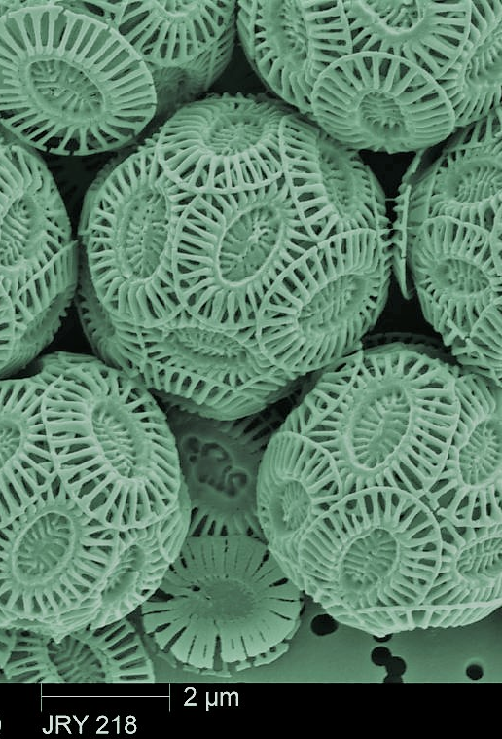
Two Coccolithophore Species
E. Huxleyi
E. Huxleyi is the third most abundant coccolithophores species in the ocean.
Study of E. Huxleyi is important because of its distribution throughout oceans and its link to the chemical balance between the atmosphere, hydrosphere, and geosphere.
G. Oceanica
G. Oceanica is another species of coccolithophores covered with coccoliths. G. Oceanica is closely related to E. Huxleyi, and it also calcifies.
The study of the G. Oceanica species is of interest since it significantly contributes to coccolithophore blooms in coastal areas

Slide 3
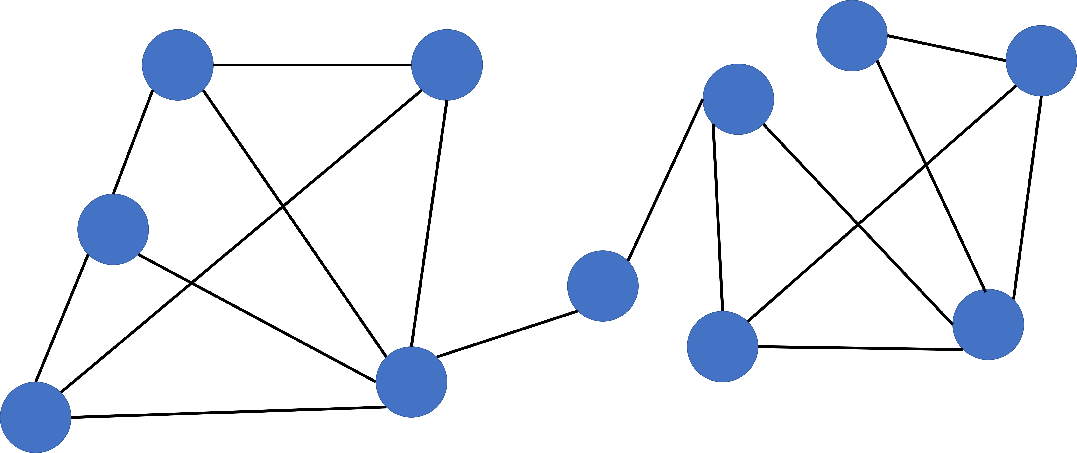
What is Gene Co-expression Network (GCN)?
GCN is an undirected graph, where each node corresponds to a gene, and a pair of nodes is connected with an edge if there is a significant co-expression relationship between them.
Nodes: Genes
Edges: “direct” co-expression between two genes

Slide 4
What is Gene Co-expression Network Analysis ?
Systems biology method for describing the correlation patterns among genes across RNA-Seq and microarray samples.

Slide 5
Weighted Gene Co-expression Network Analysis (WGCNA)
WGCNA framework was used for construction and comparative analysis of E. Huxleyi and G. Oceanica data sets
Idea is to make use of interaction patterns between genes
Genes do not function in isolation but rather they interact with other genes
This dependence pattern was harnessed in this analysis

Slide 6
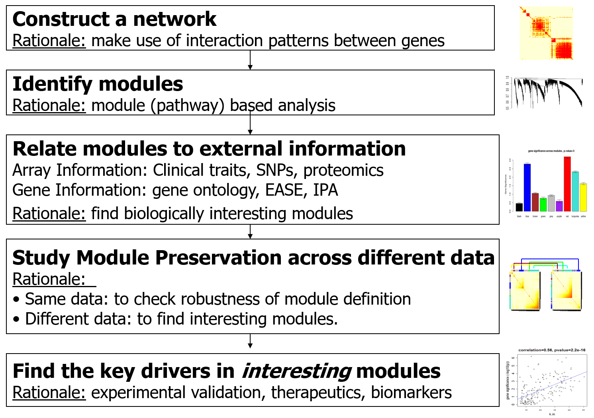
WGCNA Overview

Slide 7
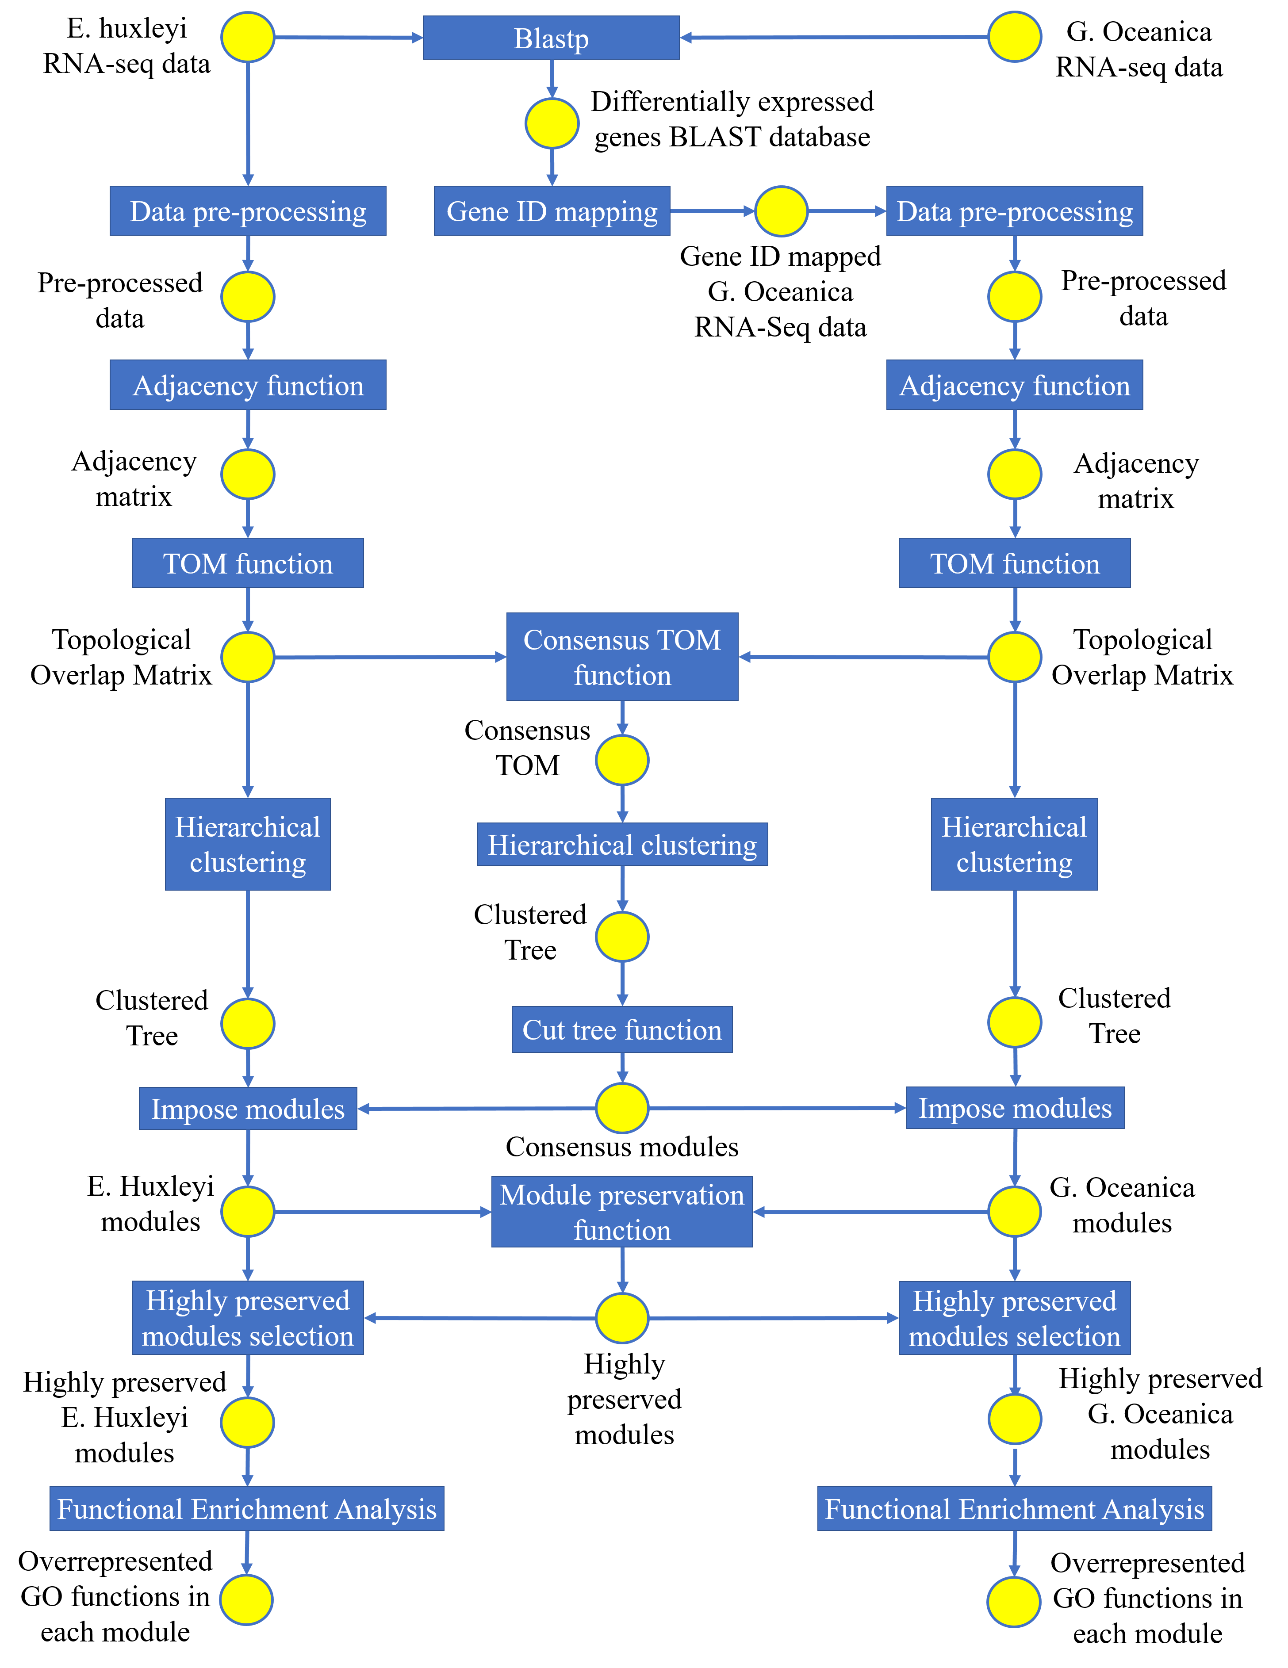
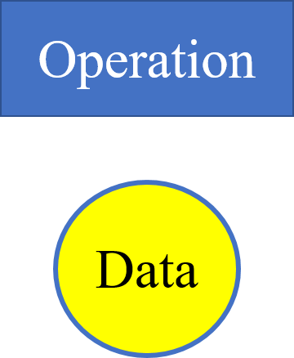
Architecture

Slide 8
Input Data Sets
RNA-Seq data of two coccolithophores species E. Huxleyi and G. Oceanica
with 0mM calcium,
with 9mM calcium,
with 0mM calcium with a spike of sodium carbonate, and,
with 9mM calcium with a spike of sodium carbonate.

Slide 9
Sample RNA-Seq data
ID | 0.1 | 0.2 | 0.3 | 0S.1 | 0S.2 | 0S.3 | 9.1 | 9.2 | 9.3 | 9S.1 | 9S.2 | 9S.3
78860 | 0 | 0 | 0 | 0 | 0 | 0 | 0 | 0 | 0 | 0 | 0 | 0
62533 | 0 | 0 | 0 | 0 | 0 | 1 | 0 | 0 | 0 | 1 | 0 | 0
62524 | 7 | 2 | 1 | 5 | 6 | 10 | 4 | 1 | 1 | 7 | 6 | 6
62542 | 143 | 2 | 2 | 1009 | 109 | 11 | 74 | 1 | 4 | 430 | 9 | 26
69477 | 4 | 6 | 2 | 11 | 26 | 21 | 3 | 4 | 9 | 3 | 23 | 6
69499 | 27 | 2 | 5 | 52 | 17 | 3 | 33 | 1 | 4 | 44 | 16 | 3
69472 | 0 | 0 | 0 | 0 | 0 | 0 | 0 | 0 | 0 | 0 | 0 | 0
69467 | 21 | 72 | 45 | 16 | 60 | 55 | 13 | 42 | 53 | 34 | 54 | 78
69471 | 0 | 0 | 0 | 0 | 0 | 0 | 0 | 1 | 0 | 0 | 0 | 0

Slide 10
Gene ID mapping
BLAST (Basic Local Alignment Search Tool) algorithm was used for comparing biological sequence information.
protein-protein BLAST (blastp) was used to compare the differentially expressed genes of E. Huxleyi to the G. Oceanica database.
The result was a list of genes that are differentially expressed in both E. Huxleyi and G. Oceanica RNA-seq data.

Slide 11
Differentially expressed genes BLAST database
E. Huxleyi ID | G. Oceanica ID | % match
124351 | evm.model.Contig61.22 | 100
46864 | evm.model.Contig1135.22 | 100
428487 | evm.model.Contig1620.12 | 100
72393 | evm.model.Contig2433.2 | 100
69699 | evm.model.Contig2920.2 | 100
198173 | evm.model.Contig2468.4 | 100
78924 | evm.model.Contig1617.8 | 100
449596 | evm.model.Contig1875.1 | 100
50671 | evm.model.Contig1047.17 | 100

Slide 12
Data pre-processing
To minimize noise due to batch effects, Column 1,4,7,10 from two data sets are discarded from two data sets.
Low-count filtering
Log-transforming data
Normalization

Slide 13
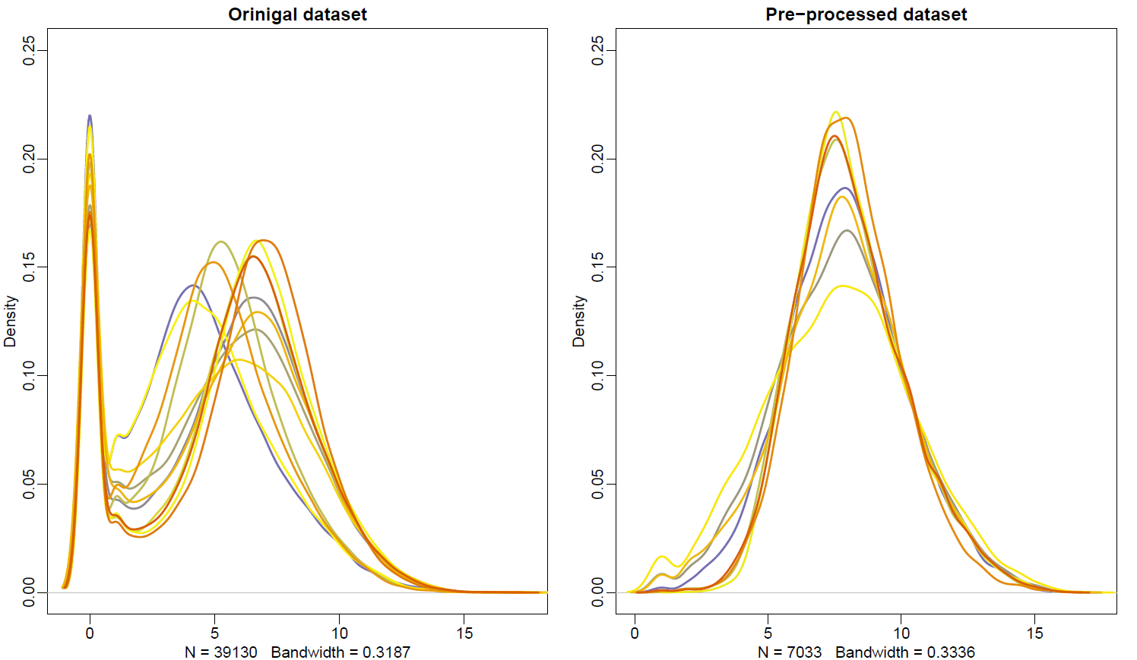
Density Plot - E. Huxleyi

Slide 14
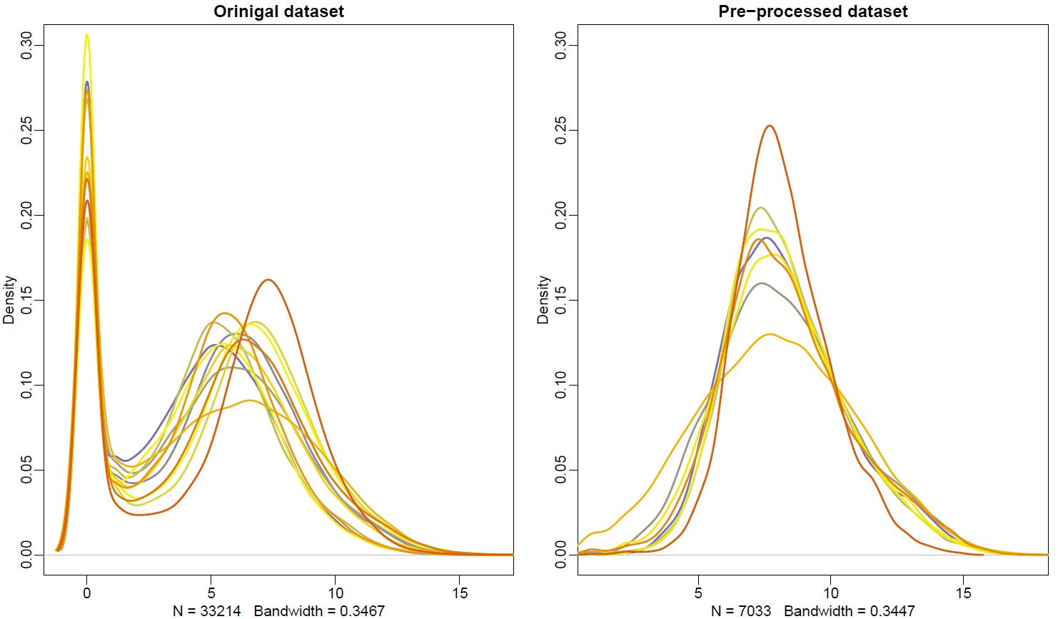
Density Plot - G. Oceanica

Slide 15
Evaluating correlation between data sets
Before performing co-expression network construction and analysis, it is important to assess the comparability of two data sets.
This was done by correlating measures of average gene expression between two data sets.
The higher the correlations, better the chance of finding similarities between the two data sets at subsequent stages of the analysis
rankExprA1= rank(rowMeans(datExprA1)) # datExprA1 contains G. Oceanica data set
rankExprA2= rank(rowMeans(datExprA2)) # datExprA2 contains E. Huxleyi data set
verboseScatterplot(rankExprA1, rankExprA2, xlab = "Ranked Expression (G. Oceanica)", ylab="Ranked Expression (E. Huxleyi)")

Slide 16
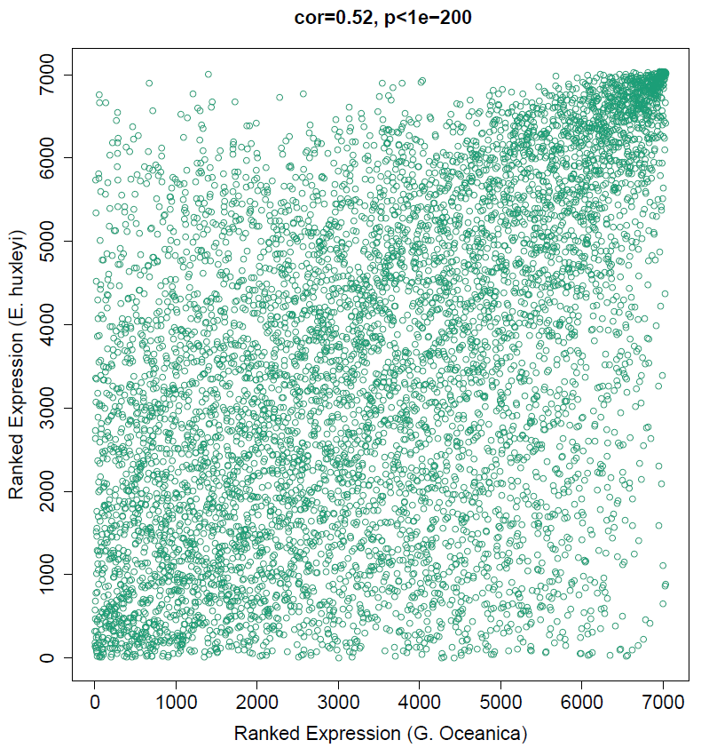
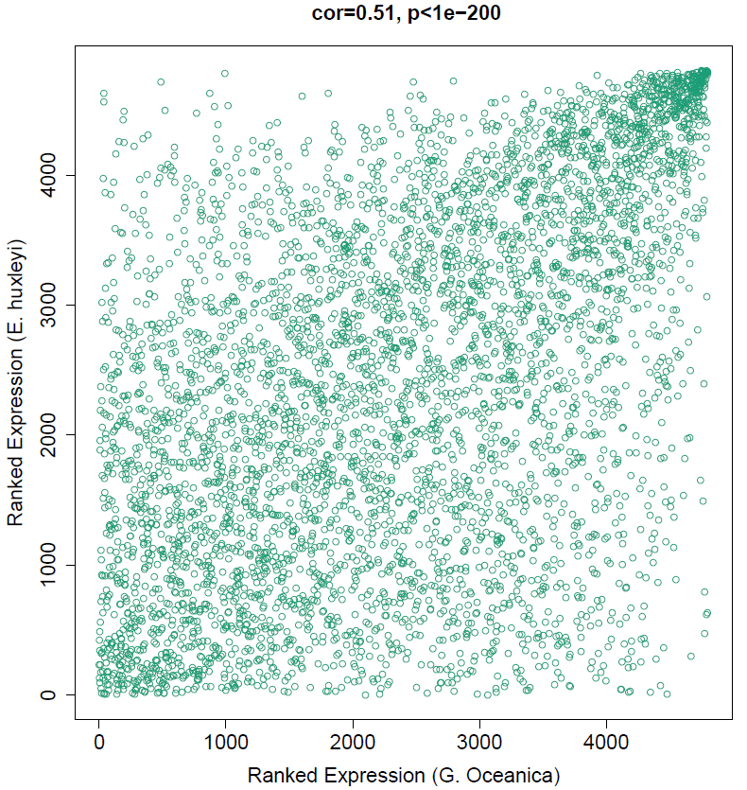
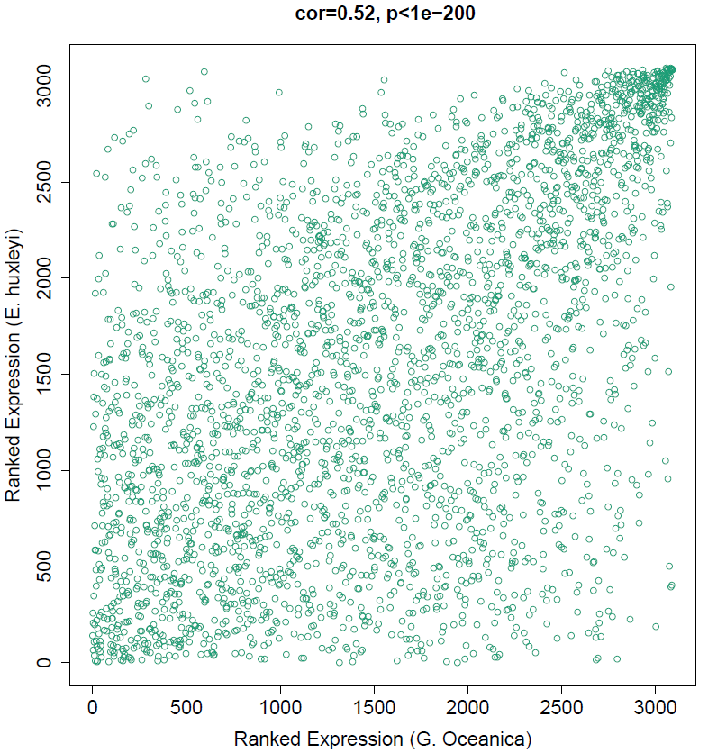
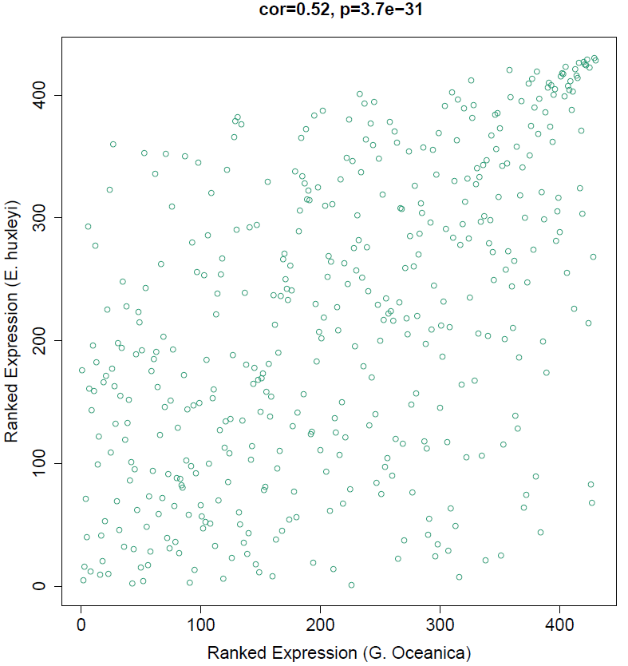
Evaluating correlation between the datasets
90% 95% 97% 100%
Correlation graph for % matched data sets

Slide 17
Network=Adjacency Matrix
A network can be represented by an adjacency matrix, A=[a_{ij}], that encodes whether/how a pair of nodes is connected.
A is a symmetric matrix with entries in [0,1]
For unweighted network, entries are 1 or 0 depending on whether or not 2 nodes are adjacent (connected)
For weighted networks, the adjacency matrix reports the connection strength between gene pairs

Slide 18
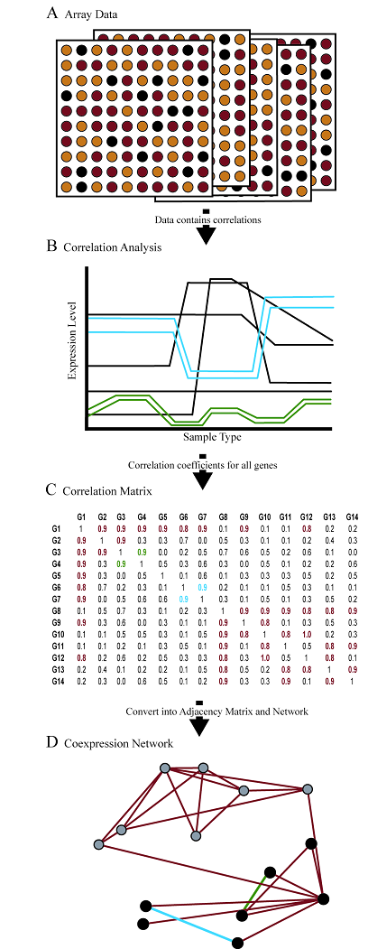
Steps for constructing a co-expression network
Gene expression data (RNA-seq)
Measure co-expression with a correlation coefficient
The correlation matrix is either dichotomized to arrive at an adjacency matrix → unweighted network
transformed continuously with the power adjacency function → weighted network

Slide 19
Weighted Network Vs. Unweighted Network
Weighted Network Unweighted View
All genes are connected Some genes are connected
Connection Widths=Connection strengths All connections are equal

Slide 20
Adjacency matrix construction
𝑎_{𝑖𝑗}=| 0.5 + 0.5 × 𝑐𝑜𝑟(𝑥_{𝑖}, 𝑥_{𝑗})|^{𝛽}
Where 𝛽 = soft-thresholding power

Slide 21
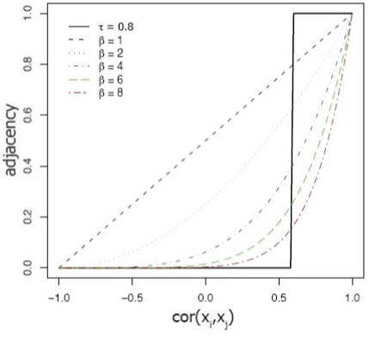
Adjacency versus correlation in weighted network

Slide 22
Soft-thresholding power selection
Raising the correlation to a power 𝛽 will reduce the noise of the correlations in the adjacency matrix.
R function pickSoftThreshold() was used to select the threshold value 𝛽

Slide 23
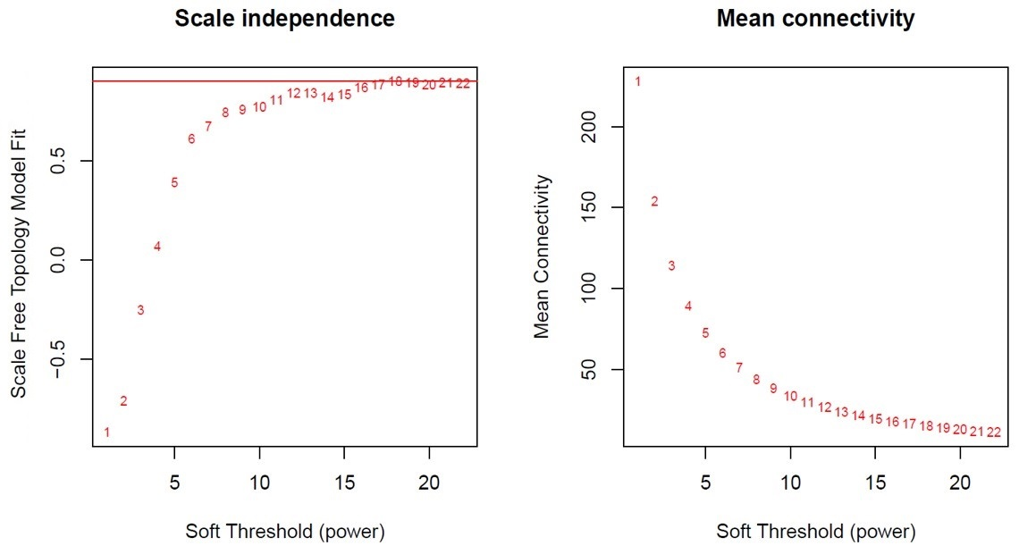
𝛽 Selection for E. Huxleyi

Slide 24
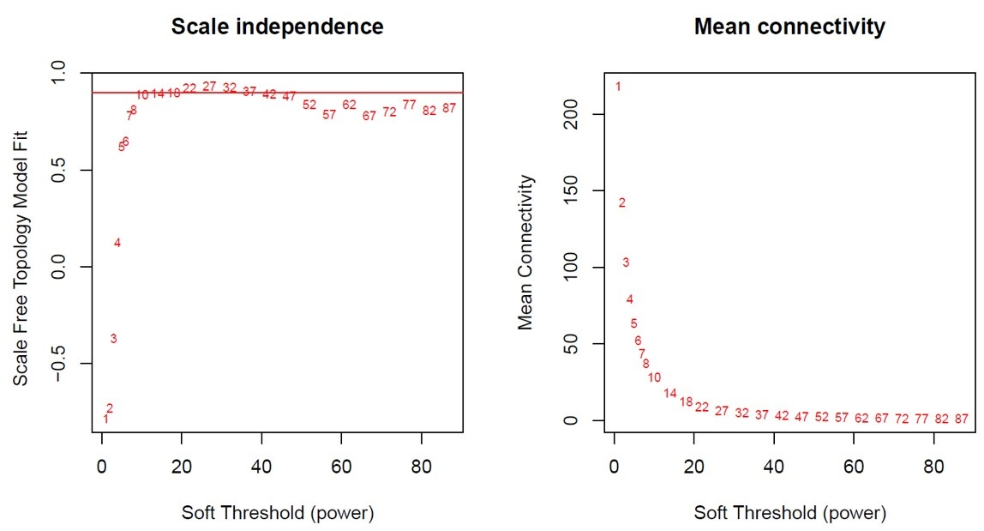
𝛽 Selection for G. Oceanica

Slide 25
Advantages of using soft thresholding
Robustness: Network results are highly robust with respect to the choice of the power B
Calibration of different networks becomes straight forward, which facilitates consensus module analysis
Module preservation statistics are particularly sensitive for measuring connectivity preservation in weighted networks

Slide 26
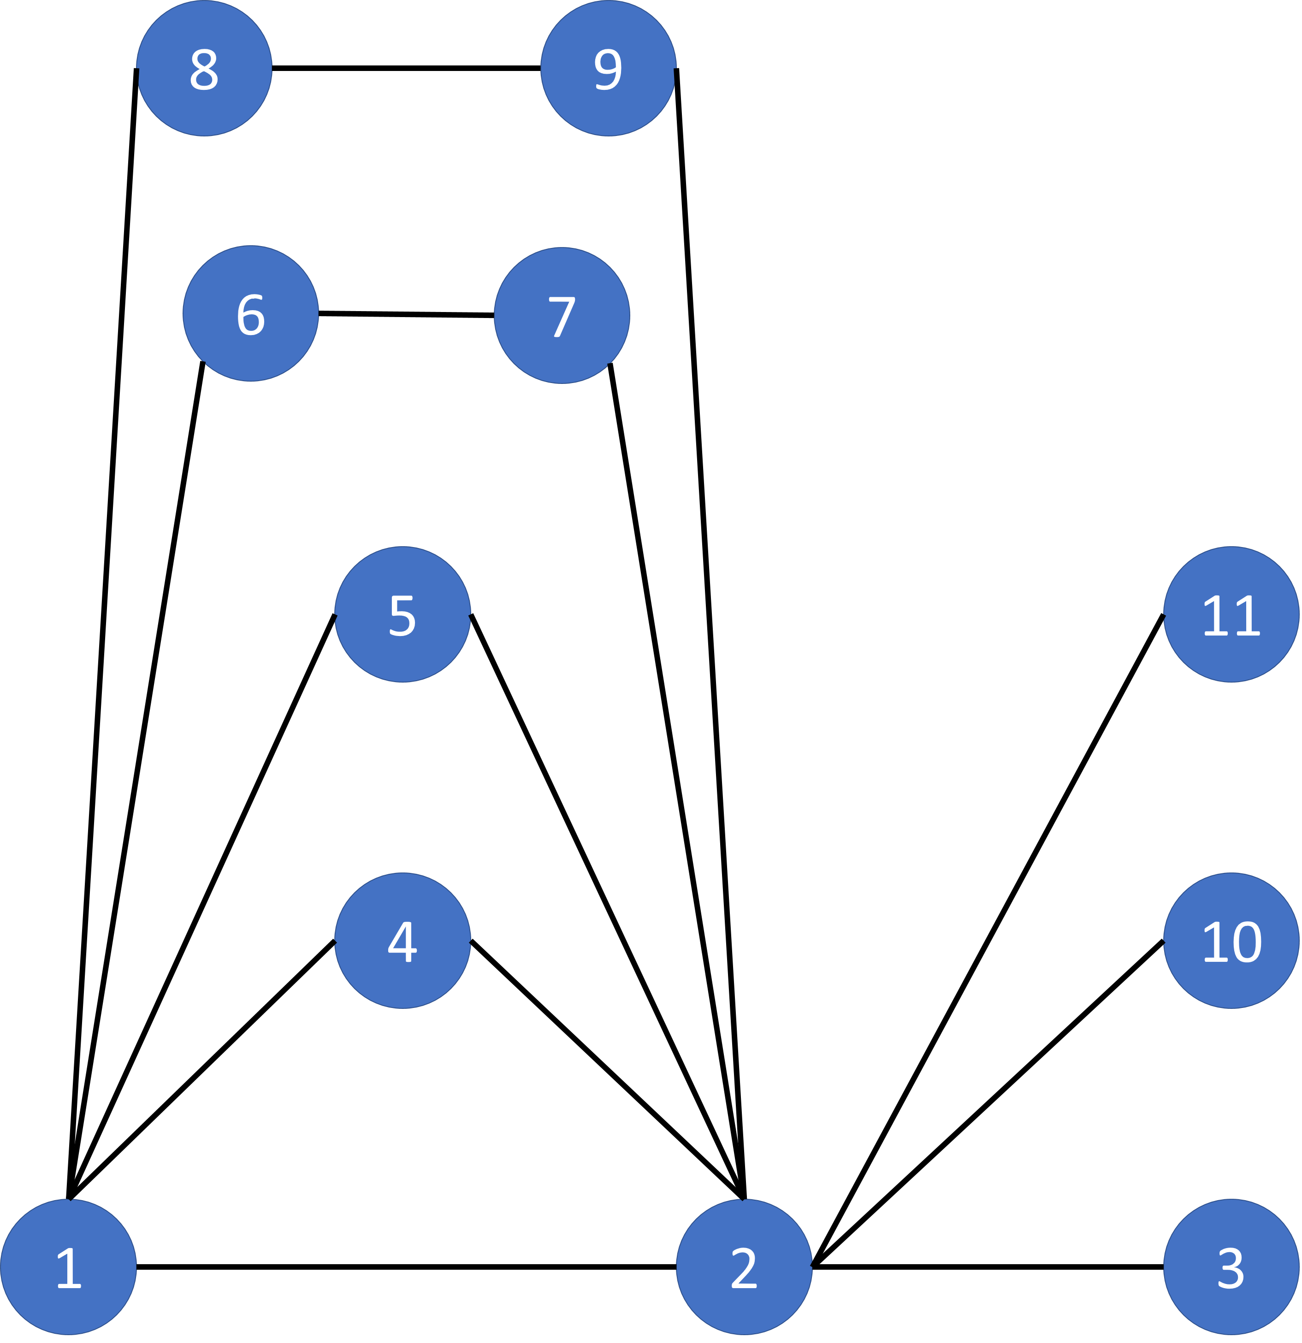
Topological Overlap Matrix based network construction
N₁(i) denotes the set of 1-step (i.e. direct) neighbors of node i
Adding 1-a_{ij}to the denominator prevents it from becoming 0.

Slide 27
Consensus TOM
Component wise minimum from 2 TOM matrices
Consensus topological overlap of two genes is only large if the corresponding entries in the two sets are also large.
Provides network structure having clusters of genes sharing many common neighbors

Slide 28
Hierarchical Clustering
hierarchical clustering coupled with the topological overlap dissimilarity measure was used.
Based on the resulting cluster tree, we define modules as branches.
Modules are either labeled by colors (turquoise, blue, brown, etc.)

Slide 29
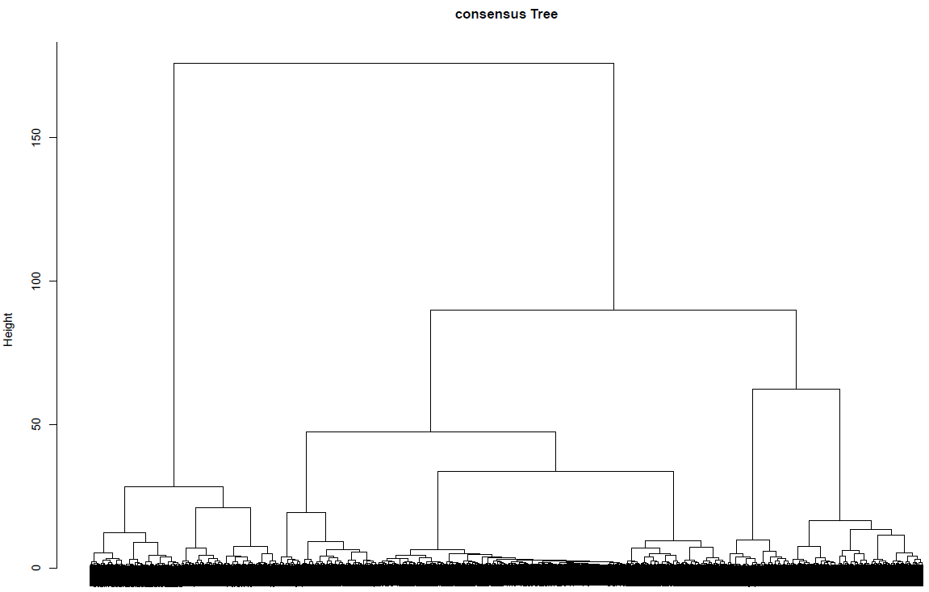
Hierarchical Clustering

Slide 30
Module identification
The consensus tree was cut at height 30 with deepSplit 2
unmergedLabels = cutreeDynamic(dendro = consTree,
distM = 1-consensusTOM,
deepSplit = 2,
cutHeight = 30,
minClusterSize = 30,
pamRespectsDendro = FALSE);

Slide 31
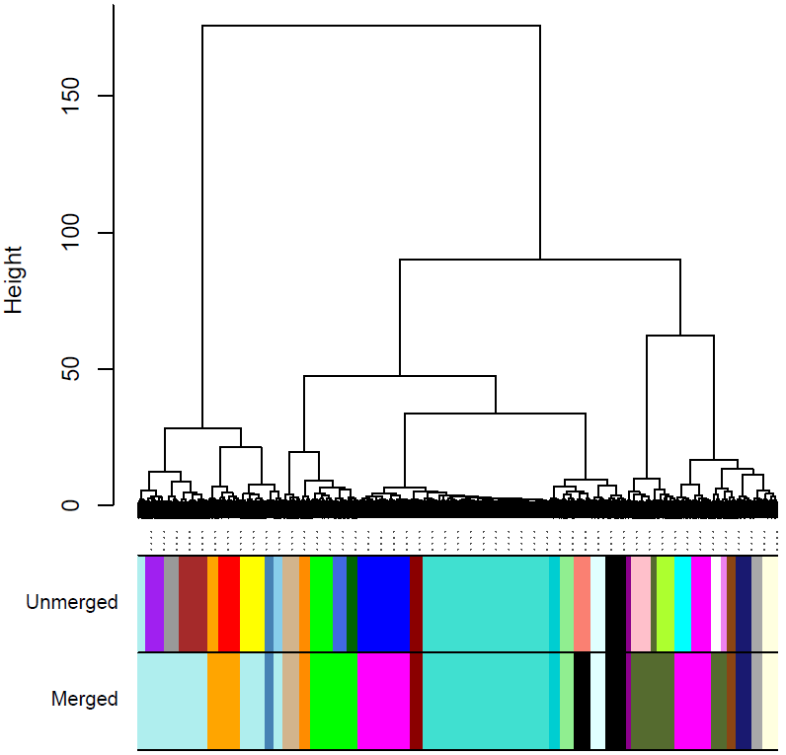
Module identification

Slide 32
Merging similar modules
Those unmerged modules can be further combined by grouping modules with similar eigen genes.

Slide 33
Module eigengene
To compare one gene module against another, it is advantageous to take only a representative of that module rather than taking all the genes.
Such module representative is called module eigengene.
That is done by performing Principal Component Analysis on each module which reduces your data meaningfully
Then by taking the first principal component as a summary of that module.
This first principal component is called "eigengene" .

Slide 34
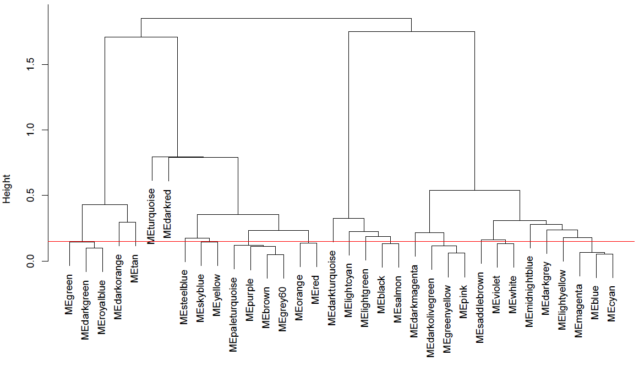
Hierarchical clustering of consensus module eigengenes

Slide 35
Hierarchical clustering of two data sets and module assignment
Hierarchical clustering analysis was also performed on each dataset (E. Huxleyi and G. Oceanica) separately and identified modules were imposed on it

Slide 36
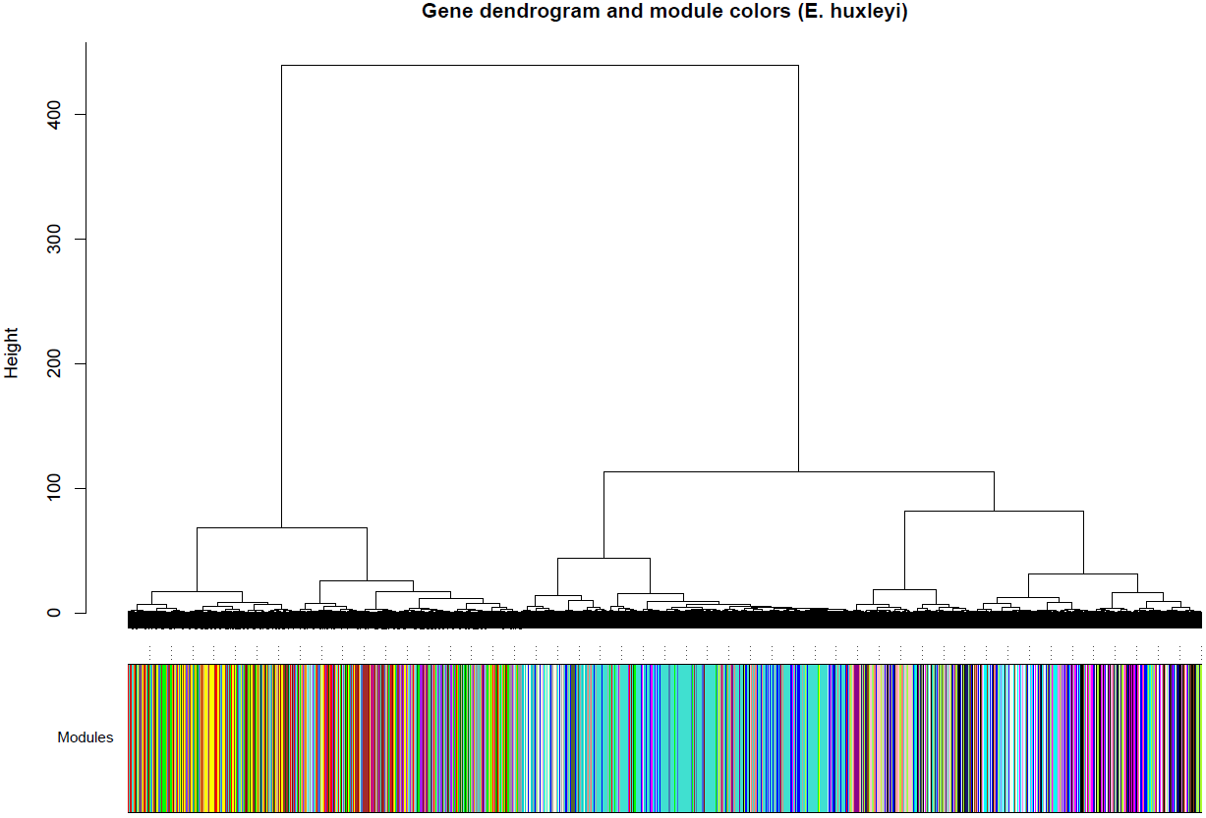
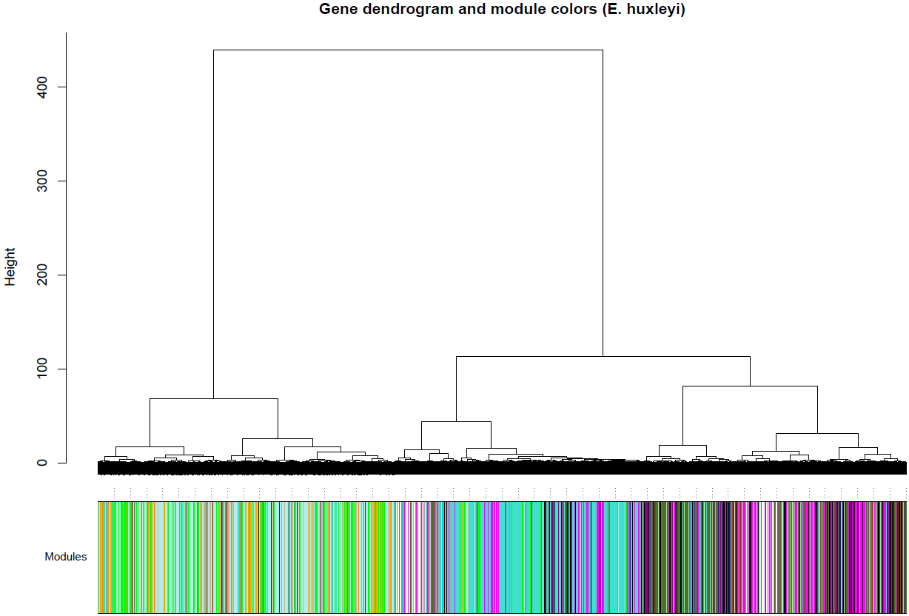
E. Huxleyi Hierarchical clustered tree and module assignment
Unmerged modules Analysis Merged modules Analysis

Slide 37
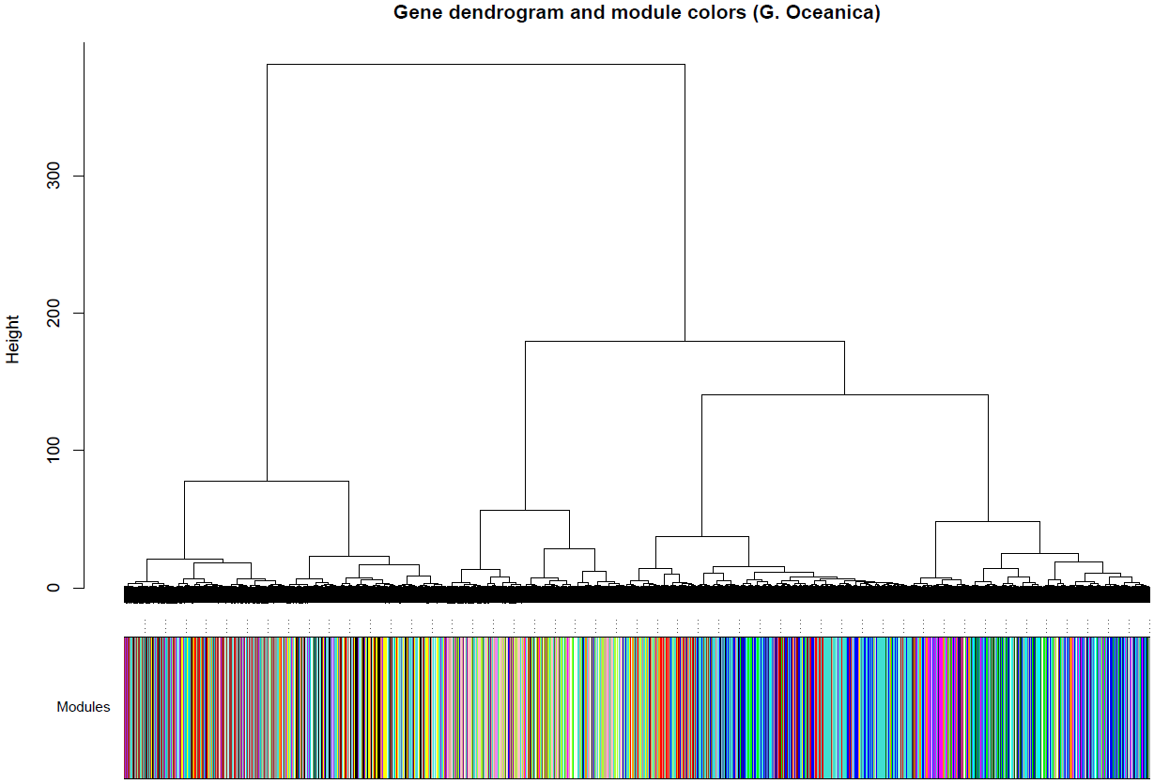
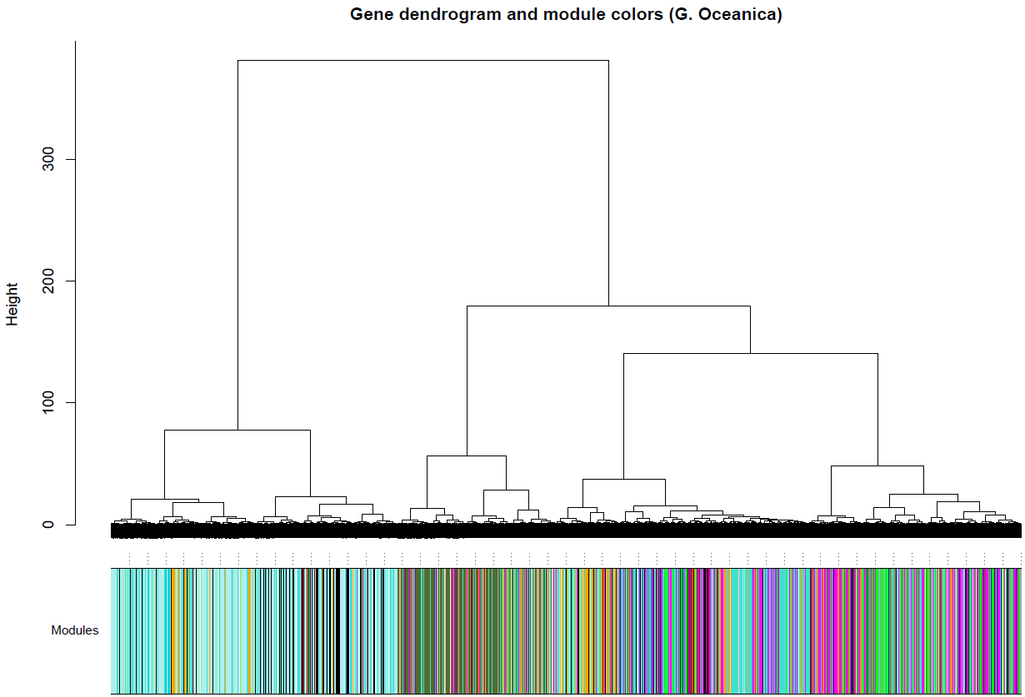
G. Oceanica Hierarchical clustered tree and module assignment
Unmerged modules Analysis Merged modules Analysis

Slide 38
Assessing module preservation
Z-Score was calculated to assess module preservation between the two networks
Z > 10 → High preservation
5 < Z < 10 → moderate preservation
Z < 5 → No preservation

Slide 39
Assessing module preservation
Module | Module Size | Z-Score
pink | 221 | 29.80328
brown | 314 | 27.04081
purple | 210 | 19.79626
grey60 | 161 | 19.58156
yellow | 274 | 18.78055
lightyellow | 153 | 18.67151
greenyellow | 196 | 18.02123
darkolivegreen | 64 | 17.54934
cyan | 182 | 16.91372
magenta | 218 | 15.71001
red | 245 | 15.25065
orange | 115 | 13.74684
Module | Module Size | Z-Score
paleturquoise | 1361 | 37.71636
darkolivegreen | 661 | 30.84493
magenta | 973 | 20.76983
orange | 360 | 17.6227
green | 529 | 17.0803
lightyellow | 153 | 16.66606
tan | 185 | 14.32406
lightcyan | 163 | 13.06638
saddlebrown | 97 | 12.72574
midnightblue | 167 | 11.53779
lightgreen | 159 | 11.48454
black | 407 | 10.87629
Unmerged modules Analysis Merged modules Analysis

Slide 40
Module-trait relationship
0Ca.NoSpike: 0mM calcium without spike of sodium carbonate
0Ca.Spike: 0mM calcium with a spike of sodium carbonate
9Ca.NoSpike: 9mM calcium without spike of sodium carbonate
9Ca.Spike: 9mM calcium with a spike of sodium carbonate
NoSpike: Spike of sodium carbonate
Spike: No spike of sodium carbonate
0Ca: 0mM calcium
9Ca: 9mM calcium

Slide 41
Module-trait relationship
ME_trait_cor = cor(ME, datTraits)
Samples | 0Ca.NoSpike | 0Ca.Spike | 9Ca.NoSpike | 9Ca.Spike | NoSpike | Spike | 0Ca | 9Ca
0.217.2 | 1 | 0 | 0 | 0 | 1 | 0 | 1 | 0
0.217.3 | 1 | 0 | 0 | 0 | 1 | 0 | 1 | 0
0S.217.2 | 0 | 1 | 0 | 0 | 0 | 1 | 1 | 0
0S.217.3 | 0 | 1 | 0 | 0 | 0 | 1 | 1 | 0
9.217.2 | 0 | 0 | 1 | 0 | 1 | 0 | 0 | 1
9.217.3 | 0 | 0 | 1 | 0 | 1 | 0 | 0 | 1
9S.217.2 | 0 | 0 | 0 | 1 | 0 | 1 | 0 | 1
9S.217.3 | 0 | 0 | 0 | 1 | 0 | 1 | 0 | 1
Traits table

Slide 42
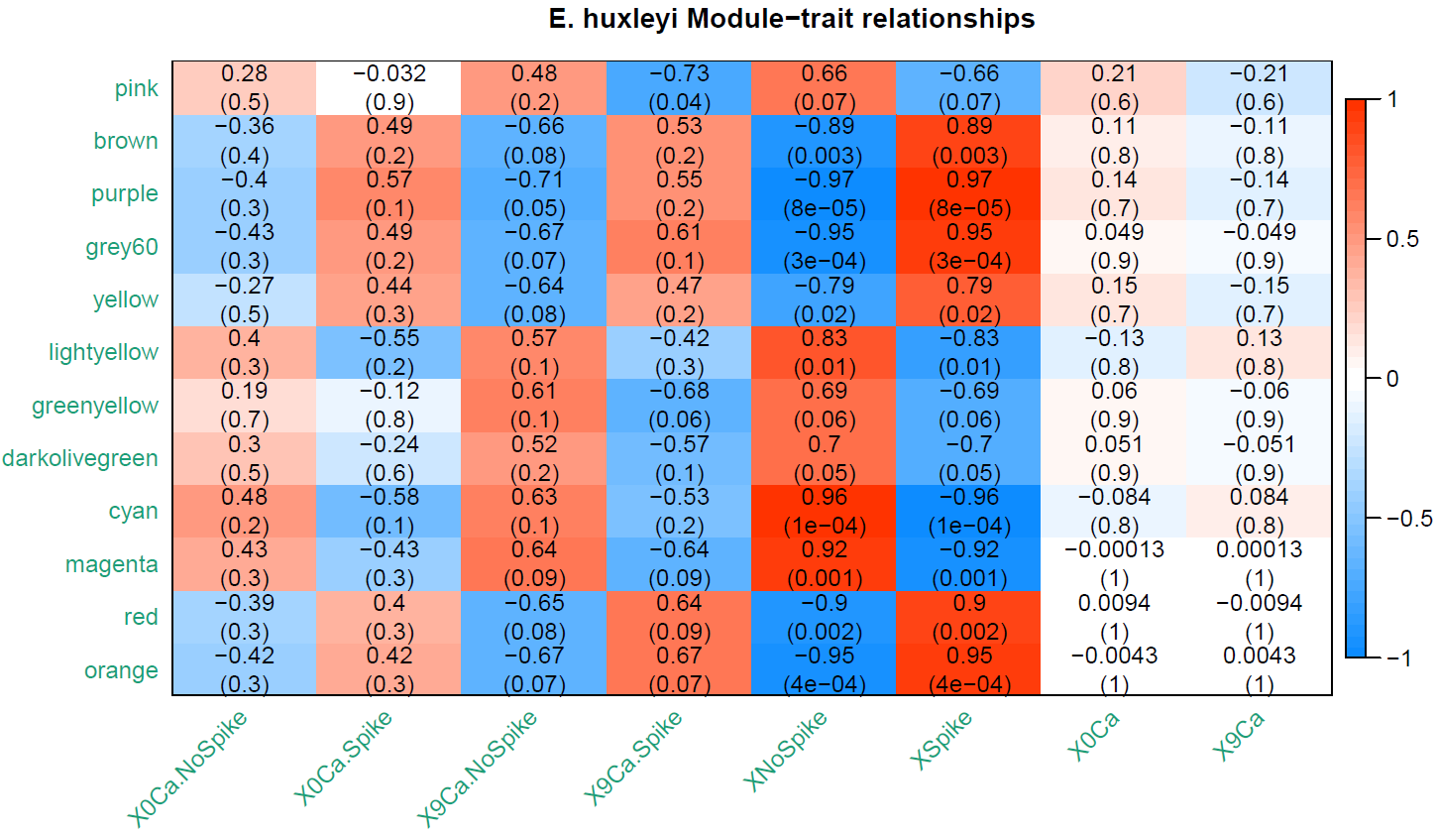
E. Huxleyi module-trait relationship
Module-trait relationship heatmap for E. Huxleyi (unmerged modules)

Slide 43
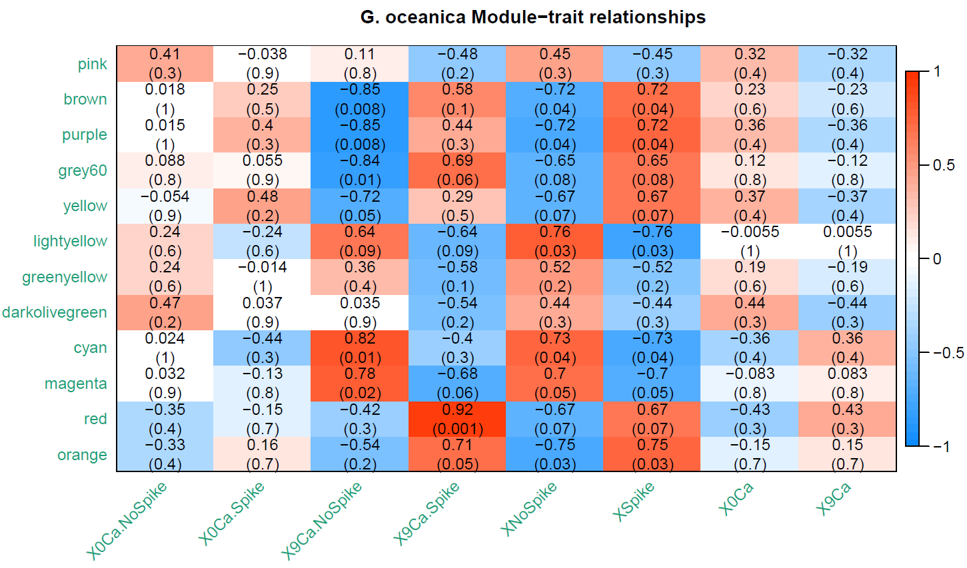
G. Oceanica module-trait relationship
Module-trait relationship heatmap for G. Oceanica (unmerged modules)

Slide 44
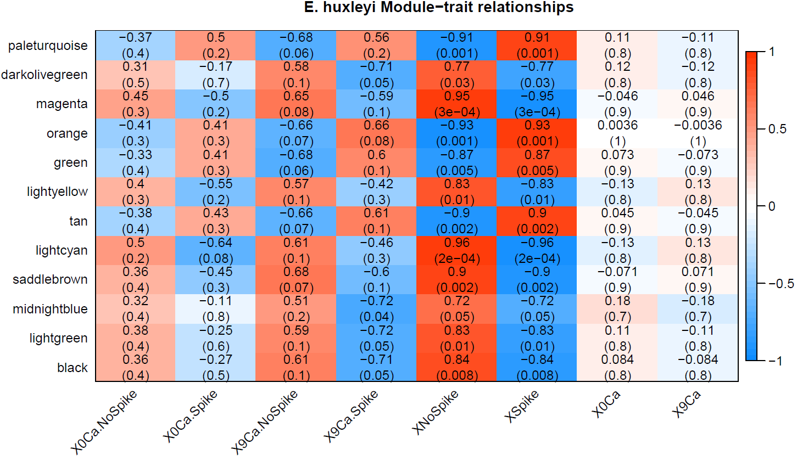
E. Huxleyi module-trait relationship
Module-trait relationship heatmap for E. Huxleyi (merged modules)

Slide 45
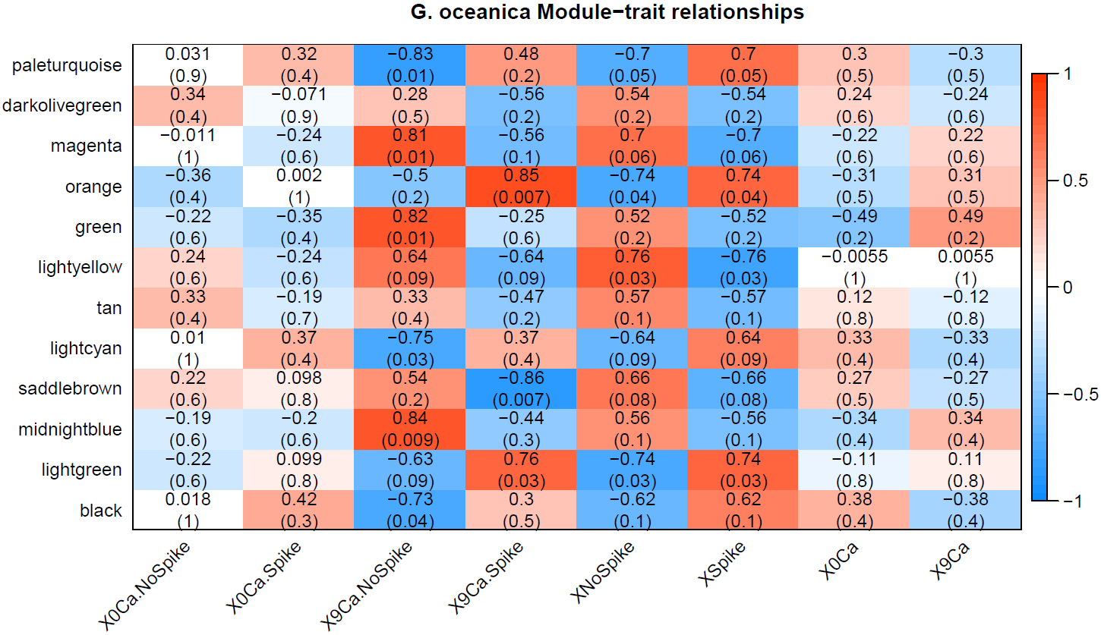
G. Oceanica module-trait relationship
Module-trait relationship heatmap for G. Oceanica (merged modules)

Slide 46
Relating modules to biomineralization genes
The investigation of genes involved in the process of biomineralization might also provide information about changes in calcification under future ocean conditions.
We have list of 85 genes which are identified as genes which takes part in biomineralization process in E. Huxleyi.
These genes are related with all modules to find out which modules they belong to
As a result, 18 biomineralization genes were identified which falls in any of the modules.

Slide 47
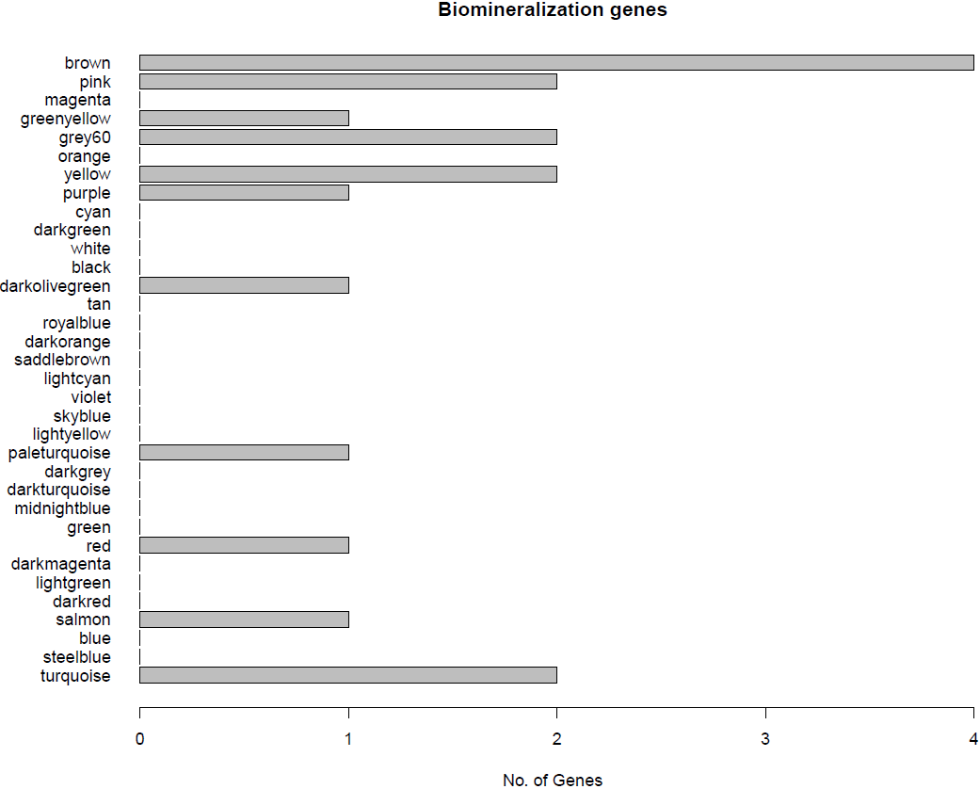
Relating modules to biomineralization genes
No. of biomineralization genes in each unmerged module

Slide 48
Biomineralization genes and GO annotation relationship
Gene ID | module | Biominer process | GO term | P-value | function | All genes with same term
416800 | brown | Ca2+/H+ exchanger (CAX3) (CAX family) | GO:0099516 | 3.45E-05 | ion antiporter activity | 200599, 354606, 416800, 433656, 453445, 99943
466232 | darkolivegreen | anion exchanger-like, SLC4 Na+ independent Cl-/HCO3- exchangers | GO:0000324 | 0.003746599 | fungal-type vacuole | 442901, 466232
439538 | grey60 | V-ATPase, A | GO:0033178 | 5.34E-08 | proton-transporting two-sector ATPase complex, catalytic domain | 433142, 435128, 439538, 461699, 95543
196760 | paleturquoise | bicarbonate transporter, anion exchanger-like Cl-/HCO3- exchangers | GO:0021860 | 0.009237543 | pyramidal neuron development | 196760
436956 | pink | anion exchanger-like, SLC4 Na+ independent Cl-/HCO3- exchangers | GO:0000324 | 0.036877167 | fungal-type vacuole | 435850, 436956

Slide 49
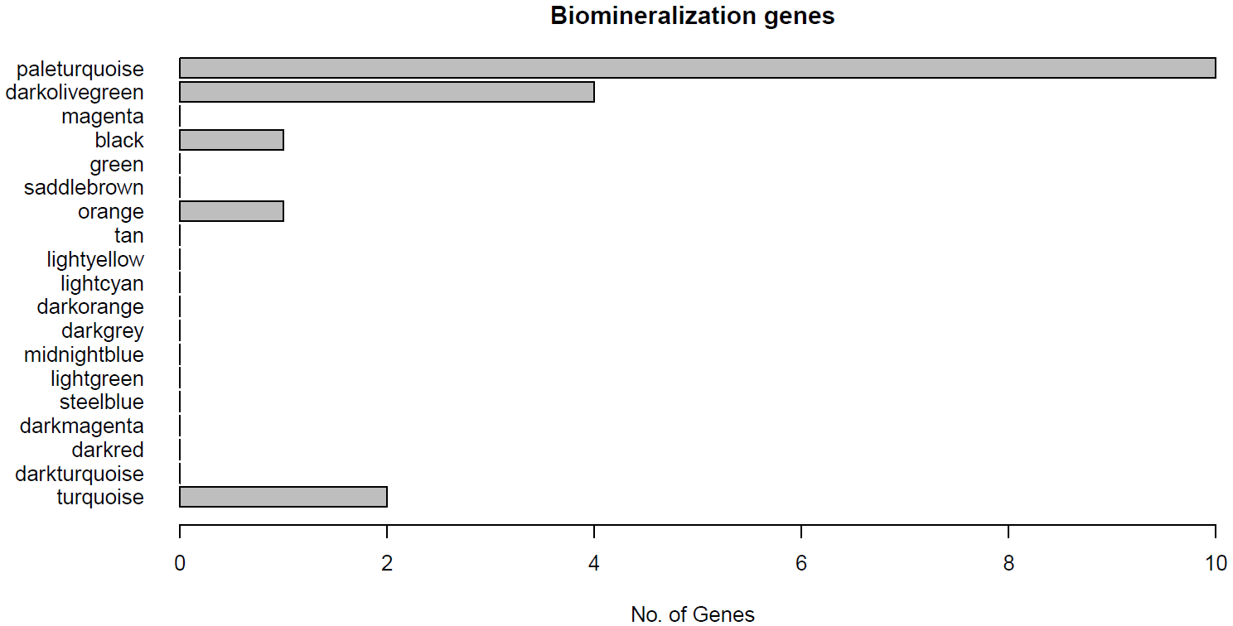
Relating modules to biomineralization genes
No. of biomineralization genes in each merged module

Slide 50
Biomineralization genes and GO annotation relationship
Gene ID | module | Biominer | GO term | P-value | function | All genes with same term
434034 | darkolivegreen | eukaryotic Na+/H+ exchanger | GO:0098657 | 0.013852678 | import into cell | 434034, 464098
439538 | paleturquoise | V-ATPase, A | GO:1902600 | 0.00013765 | hydrogen ion transmembrane transport | 196760, 216523, 413949, 433142, 435128, 439538, 457332, 461699, 95543
416800 | paleturquoise | Ca2+/H+ exchanger (CAX3) (CAX family) | GO:0015078 | 0.000119598 | hydrogen ion transmembrane transporter activity | 100529, 216523, 354280, 413949, 416800, 433142, 439538, 443369, 457332, 461699, 72273
469783 | paleturquoise | bicarbonate transporter | GO:0015301 | 8.98E-08 | anion:anion antiporter activity | 196760, 200599, 432785, 433656, 451704, 453445, 462391, 465146, 469783, 99943

Slide 51
Relating modules to lipid metabolism genes
‘Lipid metabolism’ is a process that involves the breakdown of fatty acid molecules in cells, as well as their synthesis to form more complex lipid structures
There are 707 genes which are identified as genes which takes part in lipid metabolism process in E. Huxleyi
These genes are related with all modules to find out which modules they belong to
As a result, 127 lipid genes were identified which falls in any of the modules.

Slide 52
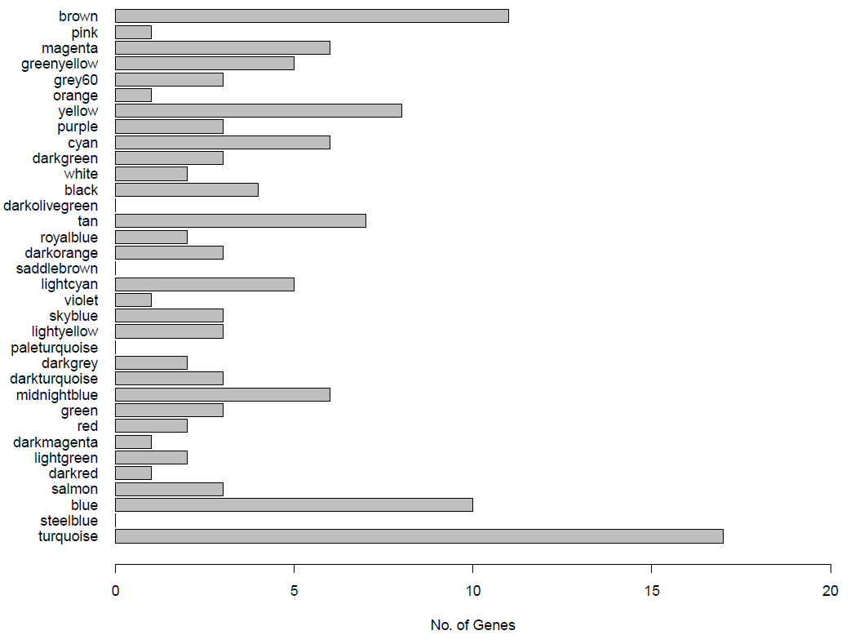
Relating modules to lipid metabolism genes
No. of lipid metabolism genes in each unmerged module

Slide 53
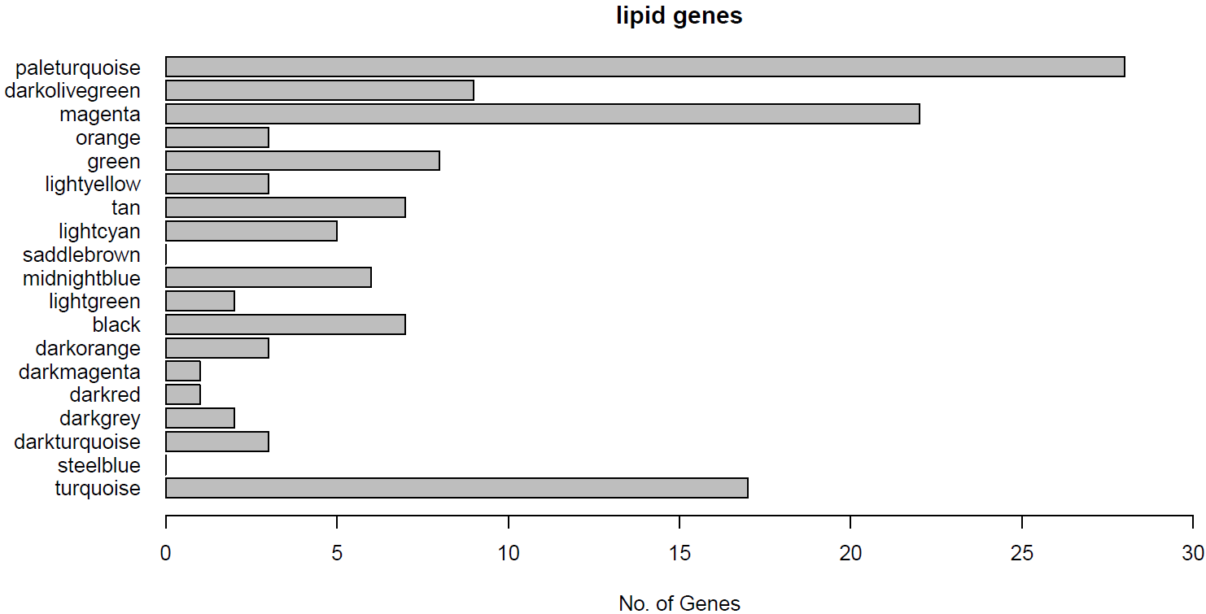
Relating modules to lipid metabolism genes
No. of lipid metabolism genes in each merged module

Slide 54
Functional Enrichment Analysis
GO enrichment analyses were performed on all modules using the Trinity Software
This analysis returns overrepresented functional categories with respect to a reference gene set (module)

Slide 55
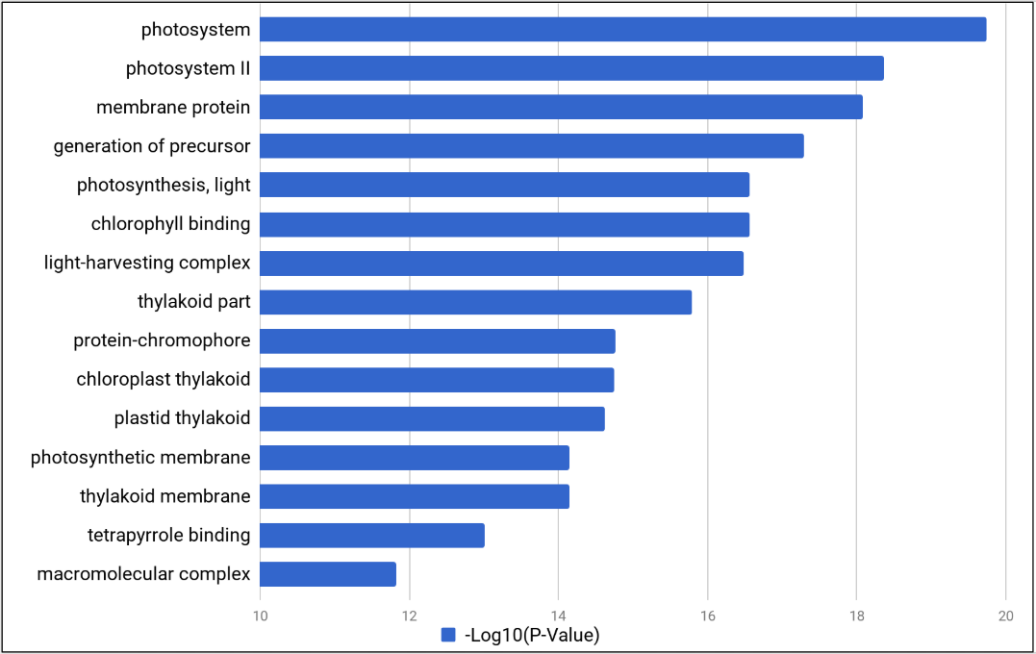
Functional Enrichment Analysis
Bar plot of -log10(P-valve) Vs. function for Gray60 module

Slide 56
Conclusion
It was found that there was substantial change in the expression levels in genes of two data sets with and without spike of sodium carbonate
Modules were either upregulating or downregulating with respect to change in growth conditions which involves spike of sodium carbonate.
There was not much of a change in expression level when modules were compared with and without 9mm calcium growth conditions.
Functional enrichment analysis was carried out on modules containing biomineralization genes to find out functions associated with biomineralization genes.
Lists of genes which can be related to set of biomineralization genes was obtained which can help to study biomineralization process in detail.

Slide 57
Future Work
Use larger data sets / microarray data sets
Make use of other gene co-expression network analysis such as HO-GSVD or DiffCoEx
Obtain more trait information for comparison

Slide 58
Questions ?

